Slide 1
Nematoda
Subclass: Phasmidia
The Intestinal Nematodes

Slide 2
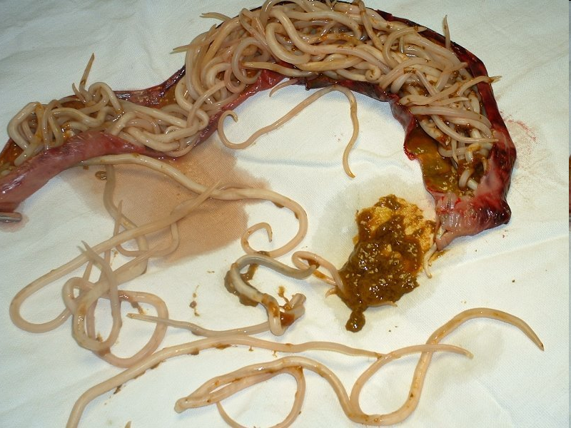
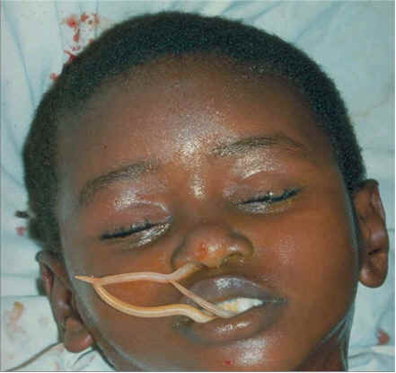
Ascaris lumbricoides
Common name /Location: Abdominal snake/ small intestine in human
Length: 25-35cm
Infective stage: egg with L2
Disease: Ascariasis
Diagnosis: Fertilized and unfertilized egg

Slide 3
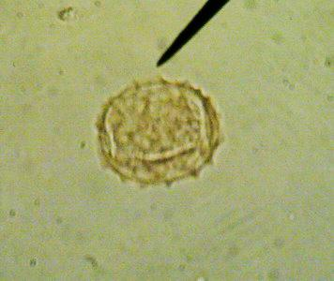
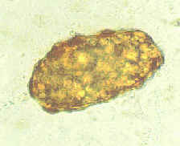
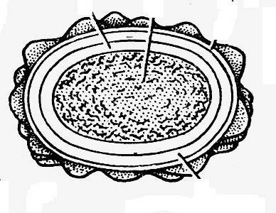
Fertilized eggs: broad oval in shape The shell is thicker and consists of, proteinaceous layer, vitelline layer, chitinous layer, lipid layer. The content is a fertilized ovum.
Unfertilized egg: Longer and slender than a fertilized egg. The chitinous layer and proteinaceous coat are thinner than those of the fertilized eggs. The content is granules various in size.

Slide 4
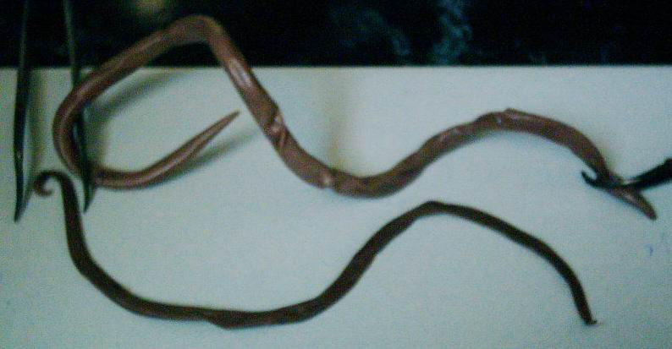
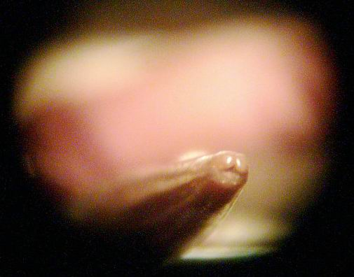
Female
male
Mouth of Ascaris lumbricoides show 3 lips

Slide 5
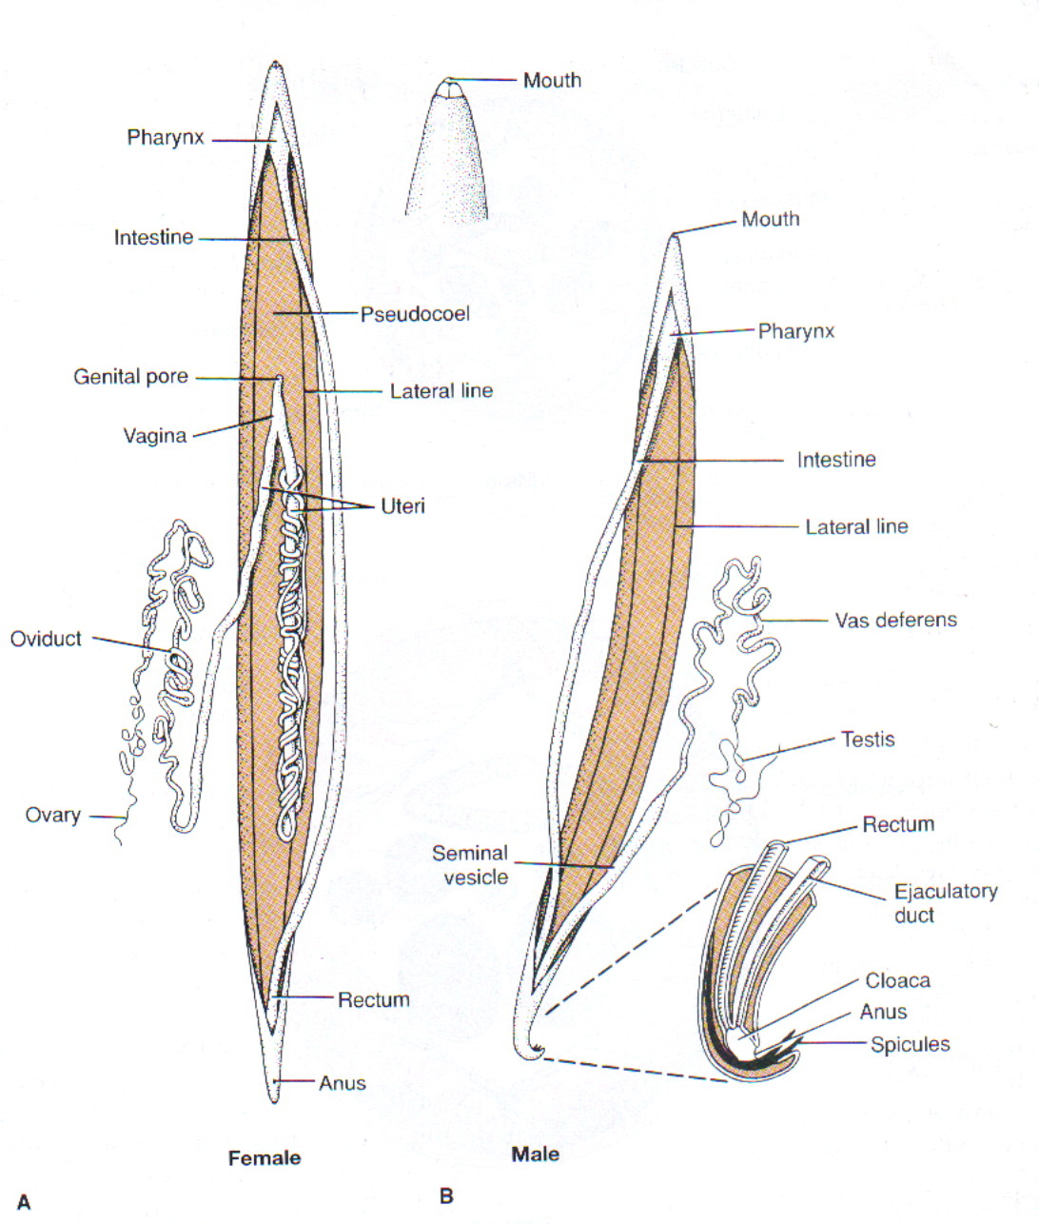
Ascaris lumbricoides
♂
♀

Slide 6
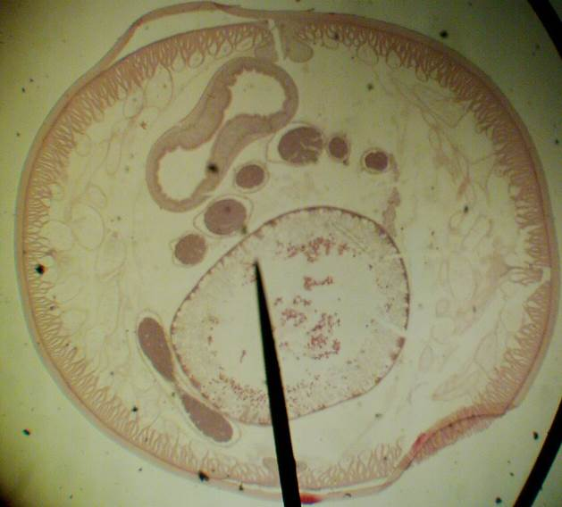
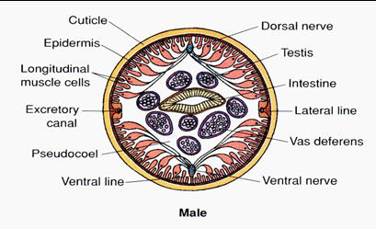
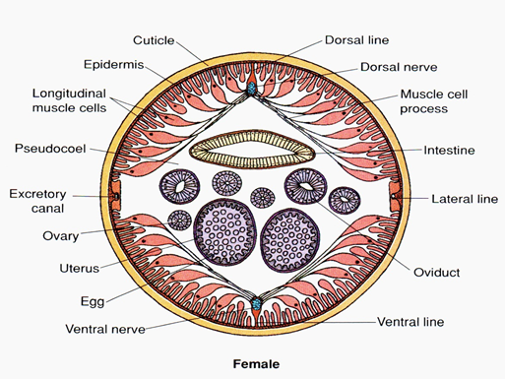
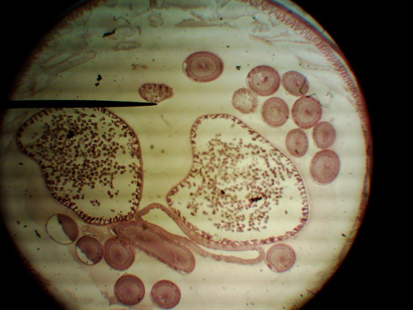
C.S Ascaris male
C.S Ascaris female

Slide 7
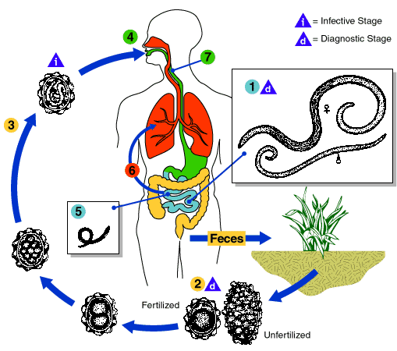
Ascaris lumbricoides life cycle

Slide 8
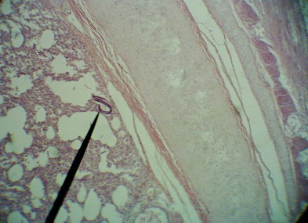
C.S in Lung Show Larva of Ascaris lumbricodis

Slide 9
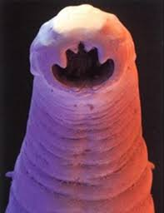
Hook Worms (الديدان الشصيه)

Slide 10
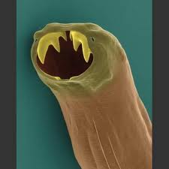
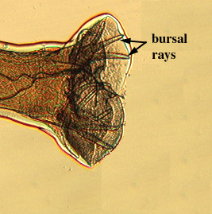
General Characteristic
Hook worms include some of worms known as Ancylostoma distributed in most of the world.
Adults lives in intestine and feed on blood and body fluids.
Hook worms have developed Buccal capsule have either teeth or cutting plates
It has Copulatory bursa in the posterior end of males.

Slide 11
Hook worms which infect human are:
Ancylostoma duodenale
Necator americanus
Hook worms which infect animal are:
Ancylostoma caninum
Ancylostoma briziliensis

Slide 12
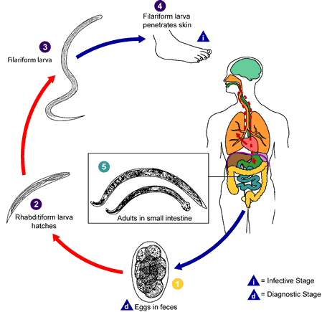
Life Cycle

Slide 13
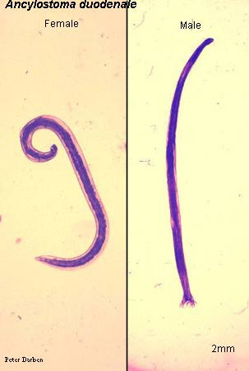
Ancylostoma duodenale
Common name: The old world hook worm
Location: Small intestine of human
Disease: Ancylostomiasis
Infective stage: Filariform larva
Diagnosis: Ova in feces

Slide 14
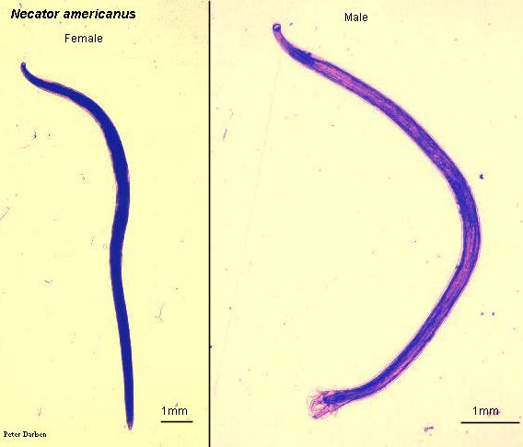
Necator americanus
Common name: The new world hook worm
Location: The adult lives in small intestine of human
Disease: Necatoriasis
Infective stage: Filariform larva
Diagnosis: Ova in feces

Slide 15
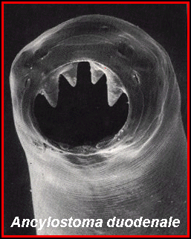
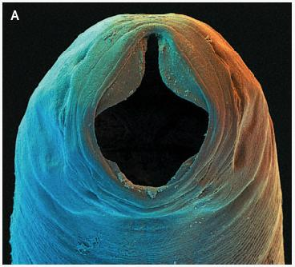
Necator americanus
The difference between Ancylostoma duodenale and Necator americanus:
Ancylostoma duodenale
Life span between 6-8 years
Anterior end turned toward dorsal side
Buccal cavity has two pairs of teeth in the ventral side
Life span between 4-6 years
Anterior end more turned toward dorsal side
Buccal cavity has one pair of semilunar cutting plates

Slide 16
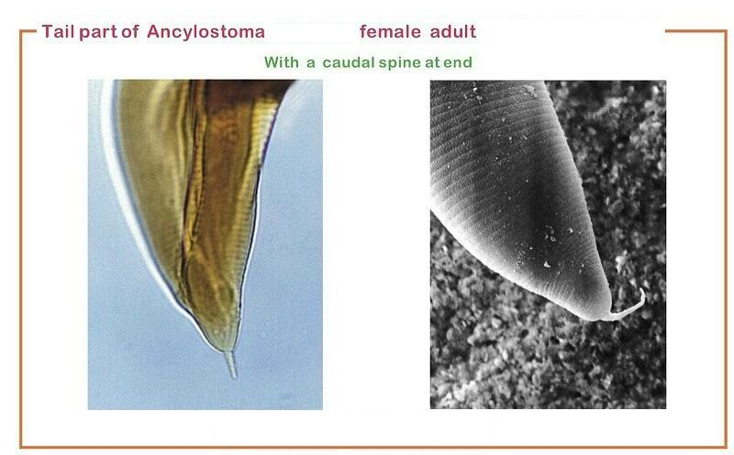
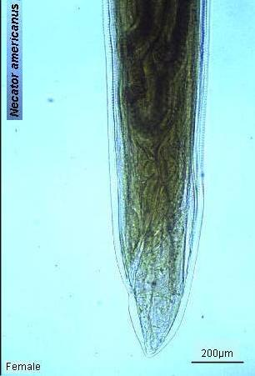
Necator americanus
Ancylostoma duodenale
The female pore in the second part of the body worm on the ventral surface.
The female put 25.000 eggs.
The female have mucron at the posterior end
The female pore in the first part of the body worm on the ventral surface.
The female put 10.000 eggs.
The female don’t have mucron at the posterior end

Slide 17
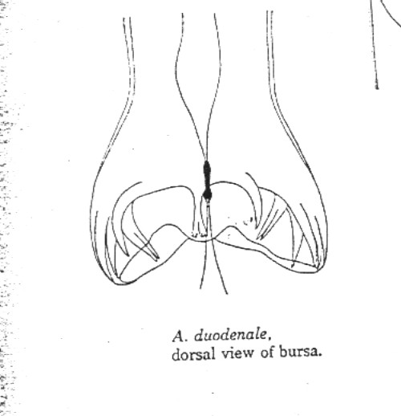
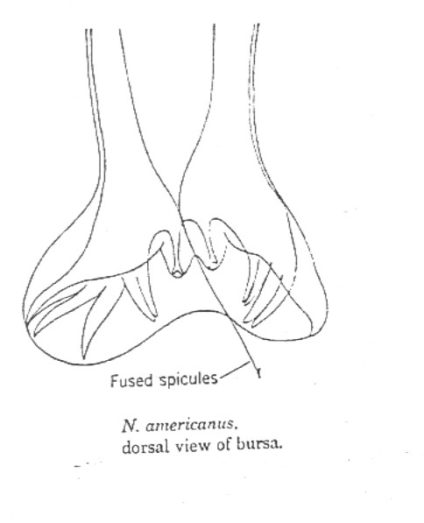
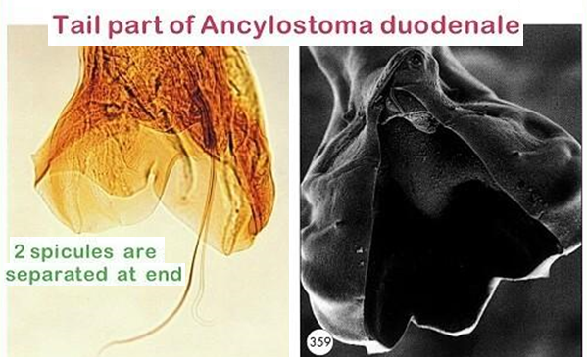
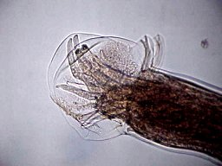
Necator americanus
Ancylostoma duodenale
Copulatory bursa is short, wide
Dorsal rays don’t deeply cleft, the end of each rays tridigitate.
The two copulatory spicules don’t fused
Copulatory bursa is long, narrow
Dorsal rays deeply cleft and the end of each bidigitate
The two copulatory spicules fused to formed one spicule.

